Slide 1
Troubleshooting Application Installation
Who’s To Blame?

Slide 2
Attention
MMS sessions are 60-75 minutes followed by LONG Q&A
Please hold detailed questions until that Q&A starts
Feel free to ask clarification questions
Remind the speakers to use Zoom It when you can’t see

Slide 3


Bryan Dam
Jim O'Neil
Patch Lover Extraordinaire - PMPC
Customer Engineer – PMPC
@bdam555
@TheJimONeil

Slide 4
Agenda
Intune App Migration – Notes from the Field
Pre-Deployment Testing (Bitness/Admin/System)
IME: The stages of the grief installation
Digging into the Logs
IME and installer logs
What it should and shouldn’t look like
Finding and decoding errors
Troubleshooting with the Graph API
Targeting
Retrieving content from a deployed app
Notes:
Bryan

Slide 5
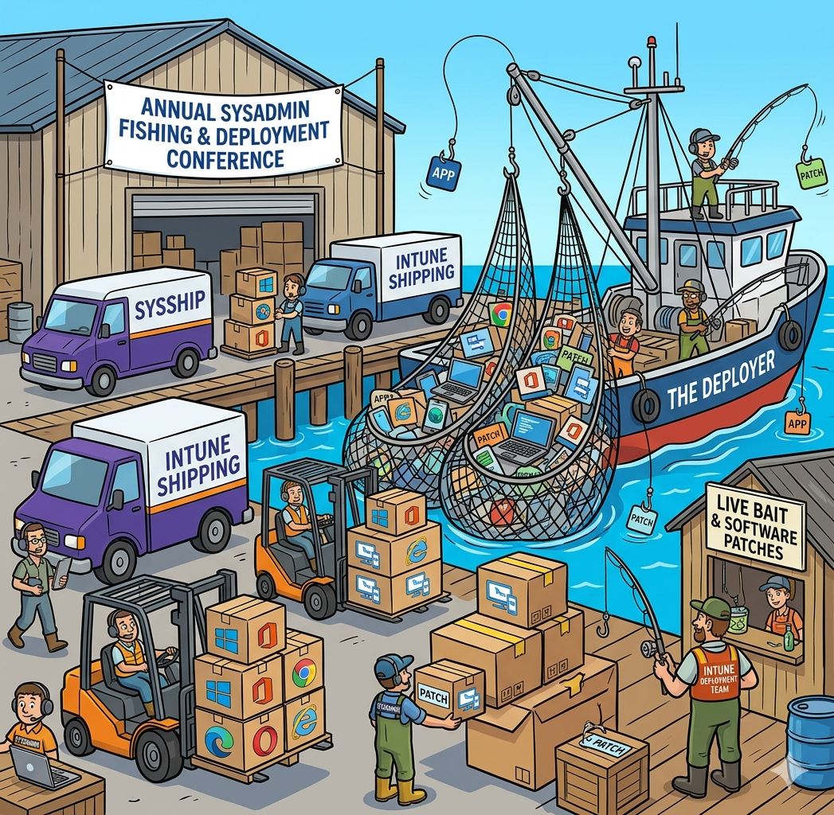
The Real Agenda
We are all in the shipping business
It often falls on sysadmins to defend our shipping business
If you tell us to ship garbage, then we will ship garbage
I’m here to try to give you the tools to prove that garbage is, in fact garbage
I’m here to try to give you the tools to prove that garbage is, in fact garbage
That might not actually help
Notes:
Bryan Poll: Who here is responsible for Just app deployment, not packaging App packaging, not deployment? Both? 90 minutes isn’t enough
There’s a whole day’s worth of material for how to fix shitty apps

Slide 6
Installer types
MSI, MSIX, EXE, PSADT

Slide 7
Installer Types
Sourceforge - Installer types
MSI
Standard format
Robust tooling
Can include TRANSFORM files (.MST)
Custom Actions
EXE
Non-standard format
May install multiple .EXE or .MSI files
Allows for installation of dependencies
Can be difficult to identify parameters
Dash or slash?
/s /silent /q /quiet /veryquiet /shutup
Notes:
Bryan
We are going to focus on MSIs for the most part because they’re still the most popular.

Slide 8
Installer Types
MSIX
New(ish) hotness!
All the benefits of and replacing UWP, App-V, MSI, Click-Once, and more.
Simpler, more secure, but limited
Appears … abandoned or finished.
Slow, but steady adoption.
PSADT
Script wrapper for .MSI, .MSIX, or .EXE
Used to standardize the unstandardized
Fix installer issues or shortcomings via Powershell
Notes:
Bryan

Slide 9
Installers: We Strayed from God’s Light
Installers should be simple
Greets user
Puts files where you tell it to
THE.
END.
Instead, we demand foot guns
Create and set registry, INI, JSON configurations
Install dependencies in a single installer (ex. DotNet, Visual C++)
Input and validate product keys
Install Windows components (IIS)
Notes:
Bryan

Slide 10
Intune App Migration
Notes from the Field
Notes:
Jim

Slide 11
Installing Company Portal
Official
Microsoft Store
Winget
Assign during Autopilot
Microsoft Download Center
Unofficial
Install during OSD Task Sequence
Notes:
Jim

Slide 12
Installing Company Portal - OSD
The Microsoft Company Portal is a user-context UWP app and cannot be installed system-wide via winget. For enterprise deployment (e.g., Intune), target user groups—especially during Autopilot or OOBE—since winget only activates post-login, limiting machine-context installs.
Stage content (prerequisites)
Run PowerShell that sets scheduled task
Scheduled task uses winget to install Company Portal on user login
Notes:
Jim

Slide 13
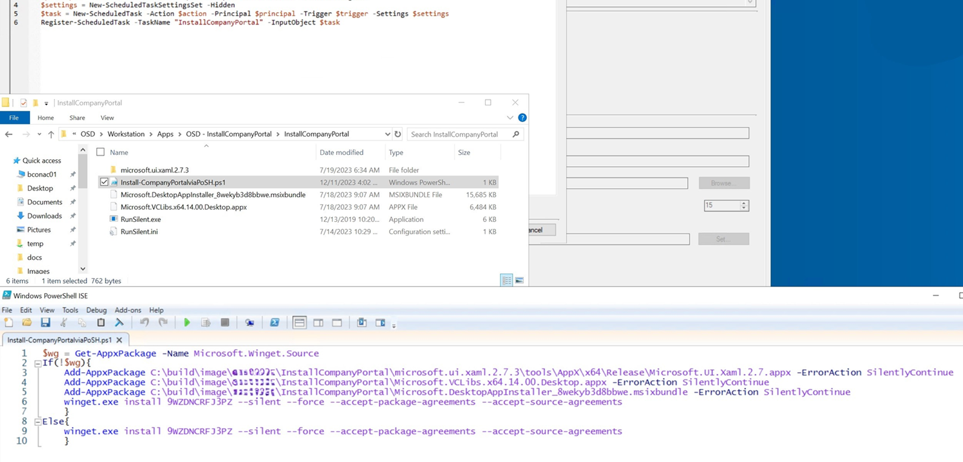
Installing Company Portal - OSD

Slide 14
Targeting Users, Not Devices (sort of...)
Old Way
Config Manager Device Collections
Slow Policy Eval
New Way
User Groups
Fast Advertisement
Apps follow user
Gotchas
Notes:
Jim
Users - preferrable for self-service scenarios
Devices - updates, security clients, required apps

Slide 15
Migration is a Journey
Spend a weekend with Cmdlets and Graph
Attrition
Treat it like a long-running projects
3rd party solutions – We may know some people...
Notes:
Jim

Slide 16
Installation Testing
Things to do BEFORE you try to deploy

Slide 17
Bitness – Consoles and Hosts
The IME is 32-bit
Use 32-bit tools when performing tests
PowerShell
64-bit = c:\Windows\System32\WindowsPowerShell\v1.0\powershell.exe
32-bit = c:\Windows\SysWOW64\WindowsPowerShell\v1.0\powershell.exe
PowerShell ISE
64-bit = c:\Windows\System32\WindowsPowerShell\v1.0\powershell_ise.exe
32-bit = c:\Windows\SysWOW64\WindowsPowerShell\v1.0\powershell_ise.exe
Command Prompt
64-bit = c:\Windows\System32\cmd.exe
32-bit = c:\Windows\SysWOW64\cmd.exe
Notes:
Bryan Important because of the corresponding Program Files, Registry, and System folders
99% of the time these are not a problem, but that 1% will kick you in the ass

Slide 18
Bitness – What About ARM?
Currently, the wild west
Generally speaking, it works just like 64-bit
Most 32 and 64 bit software works just fine on ARM64
Windows 11 only supports 64-bit ARM
The installers themselves (MSIs/EXEs) are not ARM
Detection methods are often indistinguishable from x64
There is no SysWOWARM
Notes:
Bryan

Slide 19
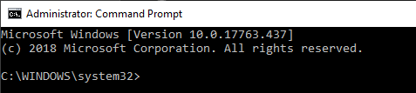
Elevation/Admin token
Admin token
You should always elevate when testing (except when installing as user)
How do I know I am elevated?
Look for Administrator in the title bar
SYSTEM
Local SYSTEM account already receives an admin token, therefore is not impacted by User Account Control (UAC)
Local SYSTEM account should have god rights to everything, but things can break and permissions can get removed
Notes:
Jim What removes SYSTEM permissions? People or bad software.

Slide 20
System Context
Default context for Intune Win32 apps
Used for device-wide installation
Inherently has admin token
No User Account Control (UAC)
Should have god rights to everything,
But sometimes installers do weird things
The SYSTEM user profile is ‘special’
Lacks some of the usual profile environment variables and folders
Poor installers, custom actions in particular, can fail
Notes:
Jim

Slide 21
Testing – Am I elevated?
PowerShell
$currentPrincipal = New-Object ` Security.Principal.WindowsPrincipal([Security.Principal.WindowsIdentity]::GetCurrent())
$currentPrincipal.IsInRole([Security.Principal.WindowsBuiltInRole]::Administrator)
Command line
net session >nul 2>&1
if %errorLevel% == 0 (
echo Success: Administrative permissions confirmed.
) else (
echo Failure: Current permissions inadequate.
)
Notes:
Jim

Slide 22
Testing – Auto elevate
PowerShell - http://www.expta.com/2017/03/how-to-self-elevate-powershell-script.html
# Self-elevate the script if required
if (-Not ([Security.Principal.WindowsPrincipal] [Security.Principal.WindowsIdentity]::GetCurrent()).IsInRole([Security.Principal.WindowsBuiltInRole] 'Administrator')) {
if ([int](Get-CimInstance -Class Win32_OperatingSystem | Select-Object -ExpandProperty BuildNumber) -ge 6000) {
$CommandLine = "-File `"" + $MyInvocation.MyCommand.Path + "`" " + $MyInvocation.UnboundArguments
Start-Process -FilePath PowerShell.exe -Verb Runas -ArgumentList $CommandLine
Exit
}
}
Notes:
Jim

Slide 23
PSExec should be Muscle Memory for Packagers
Microsoft Download: PsExec
Intended as a ‘light-weight telnet replacement’ for remote shell access
We aren’t using it that way though:
-i Runs interactively
-s Run in system context
psexec –i –s cmd.exe
Intune by default installs everything from the system context
No application should ever be deployed without running this test first
Any packager who doesn’t ask for this on day one should be fired
You should also be doing the elevated test!
Notes:
Bryan
Example: Office 365 Click2Run error dialogs

Slide 24
My Security Department Caught on to PSExec
See if they’ve heard of ServiceUI.exe
Part of Microsoft Deployment Toolkit
Surfaces UI from SYSTEM context
There’s nothing secure about this, but it works.
Deploy with care: you’re giving SYTEM to non-admin users.
Detection Rules
MSI product code 00000000-0000-0000-0000-000000000000
Cmdline
ServiceUI.exe -process:explorer.exe c:\Windows\SysWOW64\cmd.exe
Notes:
Bryan

Slide 25
Let’s Do Secure Things
Sorry, not sorry, Jordan.
Notes:
Show you can use
Bryan

Slide 26
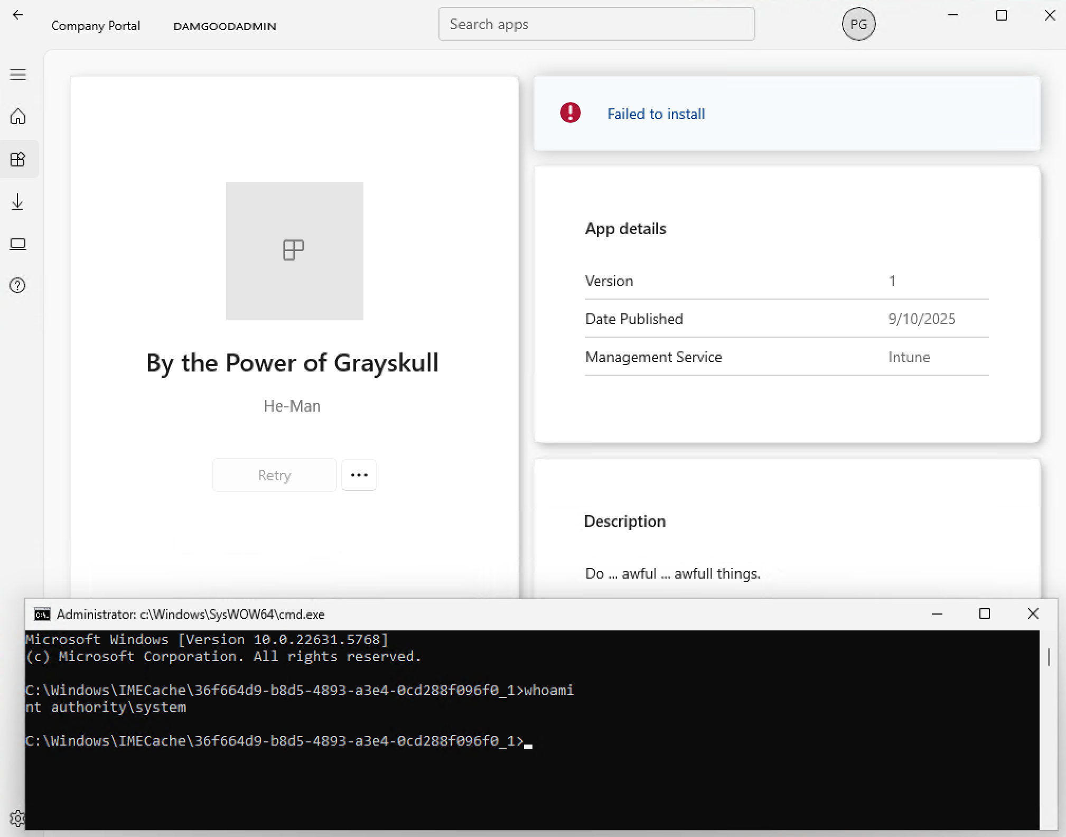
Notes:
Speaker: Bryan

Slide 27
Troubleshooting
To shoot trouble, you must first understand your enemy
Notes:
Speaker: Bryan

Slide 28
MSI Install Phases
Acquisition
Generally, the non-elevated UI portion before triggering install
Generates the install script that gets ran by the …
Execution
Elevated process that runs the install script and performs the install
Generates a rollback script of ever change made which is run by the …
Rollback
If an error occurs, executes the rollback script to return machine to previous state
There can be points of no-return baked in by the vendor
Notes:
Bryan Rollback is why Custom Actions are problematic: most packagers aren’t writing custom actions to undo things.

Slide 29
Understanding MSI Install Sequence
Docs: Suggested InstallExecuteSequence
Knowing what stage failed is important
Official Action: sequence value ends in zero (ex. 2600)
Upgrades - app might be uninstalled first
LaunchConditions: Missing pre-reqs?
AppSearch: Does it think it’s already installed?
Install/Start/Stop/Remove Service: Is the service failing to start/stop?
Install/Move/Duplicate/Patch/Remove Files: Is A/V interfering?
Notes:
Bryan

Slide 30
Let’s Look at an MSI
Up Close

Slide 31
Understanding the IME Install Sequence
Rudy’s Blog: IMECache: Attack of the Cleaner
%ProgramData%\Microsoft\IntuneManagementExtension\Logs
AppWorkload.log
Pre-detection and Applicability Phase
Downloading and Verify Phase
Decrypt and Extract Phase
Detection Phase: Part Deux
Install the Stupid Thing Phase
Detection Phase: Third Time’s a Charm?
Reporting Phase
Notes:
Bryan

Slide 32
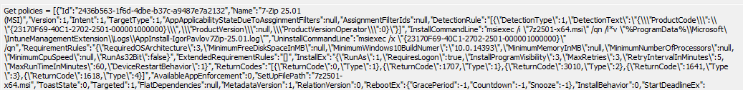
Pre-detection and Applicability Phase
Gets app policy and determines if app is installed or applicable
‘Get Policies’
JSON of app polices
One for User and one for Device targeting
Includes deployment details (Intent, Context, cmdlines, ect..)
Grab the ID field for understanding the rest of the log files
Notes:
Bryan

Slide 33
Let’s Look at Sweet Sweet Policy JSON
Take that XML
Notes:
Jim

Slide 34
AppWorkloadJsonDecoder
Purpose:
Extracts and prettifies JSON policy data from Intune AppWorkload log files for easier analysis.
What It Does:
Searches Appworkload.log for the most recent “Get policies =” entry (optionally filtered by App GUID).
Extracts the embedded JSON policy data from that log entry.
Decodes and beautifies the JSON, including any nested JSON or base64-encoded detection scripts.
Saves the output as:
A pretty JSON file.
A decoded PowerShell detection rule script.
https://github.com/thejimoneil/AppWorkloadJsonDecoder
Notes:
Jim

Slide 35
See it in action!
Notes:
Jim

Slide 36
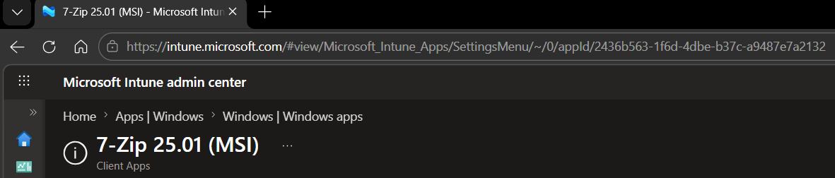
Finding the App/Policy ID
Easiest: Find it in the Portal
Hard mode: Find it in the policy JSON we showed earlier

Slide 37
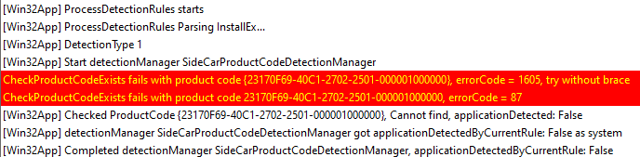
Pre-detection and Applicability Phase
ProcessDetectionRules start
Look at line above for the correct policy ID
Occurs before and after the install
Look for results: applicationDetected: True/False
Notes:
Bryan Why is this important?
Are your detection rules working as expected on this device?

Slide 38
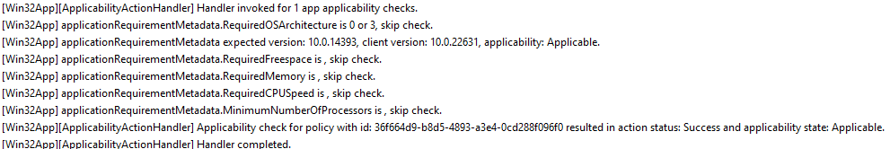
Pre-detection and Applicability Phase
[ApplicabilityActionHandler] Handler invoked
Evaluates each app individual requirement
Look for applicability state: Applicable/Not Applicable
Notes:
Bryan Why is this important?
Are your requirement rules working as expected on this device?

Slide 39
Downloading and Validation Phase
[DownloadActionHandler] Handler invoked for policy with id:
%Program Files (x86)%\Microsoft Intune Management Extension\Content\Staging\%APPID%
Sends Toast notification that app is being downloaded
Checks cache (Content cache miss for app)
Starts Delivery Optimization job
([Win32App DO] start creating a new download job)
Verifies that download matches hash value
[Win32App] Starts verifying encrypted hash
[Win32App] file hash validation pass, starts decrypting
Notes:
Bryan Why is this important?
Is A/V blocking the hash checking of the file? Is the hash value just wrong and you should recreate the intunewin file?

Slide 40
Decrypt and Extract Phase
[Win32App] Decryption is done successfully.
[Win32App] Start unzipping.
[Win32AppDownloadExecutor] Execution completed with action status: Success
Runs another app detection to make sure it didn’t magically appear
[DetectionActionHandler] Detection running for policy with id: 2436b563-1f6d-4dbe-b37c-a9487e7a2132.
Notes:
Jim Why is this important?
Did A/V get in the way of unzipping again?
Cache or disk space issues.

Slide 41
Install the Stupid Thing Phase
[ExecutionActionHandler] Handler invoked with execution type: Install
[Win32App] Create installer process successfully.
[Win32App] lpExitCode 0
[Win32App] hResultFromWin32 0
[ExecutionActionHandler] Handler completed with action status: Success.
Notes:
Bryan Why is this important? If it fails here, then it’s an installer or possible cmdline problem.
Use the exit code to understand what happened.

Slide 42
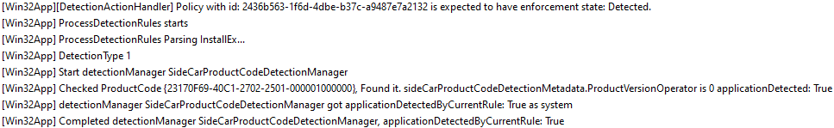
Detecting It Yet Again: Did It Install?
If you got this far then the install was ran
If the install itself didn’t spit out any errors, then it probably worked
If you fail to detect it at this point … then check your detection rules
Notes:
Jim Why does it matter? Well, if it installed without error but isn’t detected here, then your detection rules are probably wrong

Slide 43
If At First You Do Not Succeed
Deploy to your own user as available
Makes retrying easier
Delete App ID from
HKEY_LOCAL_MACHINE\SOFTWARE\Microsoft\IntuneManagementExtension\Win32Apps\{SID}\{App Id GUID}
Restart Service
Not Good Enough we have to delete the GRS key
HKEY_LOCAL_MACHINE\SOFTWARE\Microsoft\IntuneManagementExtension\Win32Apps\{SID}\{GRS}
That’s all too hard, use a remediation script
Run it on demand
John Marcum: Automate Rerunning Failed Intune Win32 App Installs
Rudy Ooms: Retry Win32 App Lola Retry
Win+R: intunemanagementextension://syncapp
Notes:
Bryan

Slide 44
Installer Logs
You knew this was coming
Notes:
We’re going to focus on MSI logs because they’re the best.

Slide 45
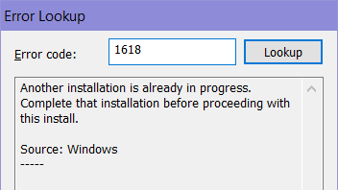
Log Viewer: There Can Only Be One
And it’s CMTrace
Seriously, use CMTrace
Even the Intune team knows this
Filtering (ex. Contains ‘Doing Action’)
Best error code lookup
Ctrl+C, Ctrl+L, Ctrl+V, Enter
Notes:
Bryan

Slide 46
Logs: MSI
MSI and others
Verbose logging: Always use /l*v <path>
You don’t need it; until you need it!
Use IME log folder to include them in diagnostic collection
Use %ProgramData%\Microsoft\IntuneManagementExtension\Logs
Standardize log file name (ex. AppInstall-VendorProduct-Version.log)
This will include them when running diagnostic collection
Notes:
Bryan

Slide 47
One Trick Big Install Does Want you to Know
MSDN: Finding MSI error 1603 root cause
1603 means a custom action failed
95% of all failures are custom actions
Open log file
Scroll to the top
Search for “return value 3”
…
Profit
Notes:
Bryan

Slide 48
Let’s Look at Some Log Files
The anticipation is killing me
Notes:
Show you can use

Slide 49
Logs: Event Logs - MSI
Greg Ramsey: Win32_Product is EVIL!
Where to look?
Log: Application
Source: MsiInstaller
What’s included?
User
Process ID
Source path
Typical entries
Begin a windows installer transaction
Success or failure
Exit code
End a windows installer transaction
Notes:
Bryan

Slide 50
Using the Graph API
For fun AND profit!
Notes:
Bryan

Slide 51
Intune Assignment Checker – Ugur Koc
https://github.com/ugurkocde/IntuneAssignmentChecker
Lists any assignments for a given device, user or group
Can auth interactively or use an app registration for automation.
Install from Powershell Gallery:
Install-Module IntuneAssignmentChecker -Scope CurrentUser
Run: IntuneAssignmentChecker
Notes:
Bryan

Slide 52
Let’s Check Some Policies
I love me some cmdline
Notes:
Bryan

Slide 53
Download Win32 App Content
Blog: Download IntuneWin Win32 App Files Directly from Intune
Rudy reverse-engineered the IME
Uses the enrollment cert and creates a bearer token to call API directly
Downloads the content info, including decryption key
Decrypts and extracts the .intunewin package
Modify the script with App Id and version
Run as administrator on a box where appears in Company Portal

Slide 54
Links
Deploy Company Portal via OSD
https://github.com/thejimoneil/OSD-InstallCompanyPortal
Intune App Log Analyzer
https://github.com/thejimoneil/AppWorkloadJsonDecoder

Slide 55
Let’s Download that Content
I love me some reverse engineering
Notes:
Bryan

